Slide 1
ADO VBA Programming in Access

Slide 2
Why its not simple 1
MS Access has a 'built-in' database engine called Jet – which you might use
But you might instead use a separate data server
Like MS SQLServer, Oracle or MySQL
These work slightly differently

Slide 3
Why its not simple 2
The actual data (and server) might be on the same machine that Access is running on
But it might not

Slide 4
Why its not simple 3
The actual data (and server) might not be a relational database
Could be a web page or spreadsheet

Slide 5
So
ADO = Active Data Objects is a single object model to cover all cases
therefore pretty intricate (but can be simple)
Here we only cover –
  running from VBA in Access
  using a local Access database

Slide 6
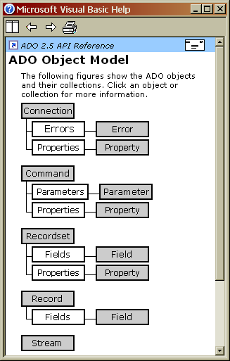
Fundamental objects
Connection
Recordset

Slide 7
Connection
Represents a single session with a data provider. The sequence is –
Set up connection
Open connection
Do things with the data
Close the connection

Slide 8
Recordset
A recordset is just a set of records (rows)
Open a recordset (through a connection)
Do something with the rows
Close the recordset

Slide 9
Simple example
An Access database has a table called myTable and a key field called ID
The following code (in a button on a form) goes through the table and displays all teh IDs

Slide 10
Simple example : part 1
'declare conn to be a Connection -
Dim conn As ADODB.Connection
' make a connection object -
Set conn = New ADODB.Connection
' specify what kind of data provider it is -
conn.Provider = "Microsoft.Jet.OLEDB.4.0"
' open the connection on one database -
conn.Open "c:/walter/ass21.mdb"
' declare a recordset -
Dim myTableRS As ADODB.Recordset
' make one -
Set myTableRS = New ADODB.Recordset
' open it using a table in the database, and the connection
myTableRS.Open "myTable", conn, adOpenDynamic, adLockPessimistic

Slide 11
Simple example : 2
' go to start of recordset -
myTableRS.MoveFirst
' until we reach the end..
Do Until myTableRS.EOF
' display the ID field in current row
MsgBox (myTableRS.Fields("ID"))
' move next row
myTableRS.MoveNext
Loop
'close the recordset
myTableRS.Close
Set myTableRS.ActiveConnection = Nothing
' and the connection
conn.Close
Set conn = Nothing

Slide 12
Reading a table
Make a database and a table with a numeric field and a text field. Put in a few rows.
Write a routine like the above example, to total the numeric field and display it with a MsgBox

Slide 13
Find
Find Method (from Microsoft Help file..)
Searches a Recordset for the row that satisfies the specified criteria. Optionally, the direction of the search, starting row, and offset from the starting row may be specified. If the criteria is met, the current row position is set on the found record; otherwise, the position is set to the end (or start) of the Recordset.
(works matching one field only)

Slide 14
Finding a record - example
Dim conn As ADODB.Connection
Dim myTableRS As ADODB.Recordset
Set conn = New ADODB.Connection
Set myTableRS = New ADODB.Recordset
conn.Provider = "Microsoft.Jet.OLEDB.4.0"
conn.Open "c:/walter/ass21.mdb"
myTableRS.Open "myTable", conn, adOpenStatic, adLockOptimistic
Dim wanted As String
Text5.SetFocus
wanted = Text5.Text
myTableRS.Find "ID = " & wanted
If Not myTableRS.EOF Then
Label8.Caption = myTableRS.Fields("Name")
Else
Label8.Caption = "Not found"
End If
Find a row with a certain key field value and display other field
Get required value from a text box
Do the Find
Display result

Slide 15
Find record exercise
Use the above to find and display values

Slide 16
Altering data - upDate
Dim conn As ADODB.Connection
Dim myTableRS As ADODB.Recordset
Set conn = New ADODB.Connection
Set myTableRS = New ADODB.Recordset
conn.Provider = "Microsoft.Jet.OLEDB.4.0"
conn.Open "c:/walter/ass21.mdb"
myTableRS.Open "myTable", conn, adOpenStatic, adLockOptimistic
myTableRS.MoveFirst
Do While Not myTableRS.EOF
myTableRS.Fields("PhoneNumber") = myTableRS.Fields("PhoneNumber") + 1
myTableRS.Update
myTableRS.MoveNext
Loop
myTableRS.Close
Set myTableRS.ActiveConnection = Nothing
conn.Close

Slide 17
UpdateBatch
myTableRS.Open "myTable", conn, adOpenStatic, adLockOptimistic
myTableRS.MoveFirst
Do While Not myTableRS.EOF
myTableRS.Fields("PhoneNumber") = myTableRS.Fields("PhoneNumber") + 1
myTableRS.MoveNext
Loop
myTableRS.UpdateBatch

Slide 18
Practice with update
Try using update as above
Try updatebatch
Combine find with update to change selected records only –
  in a loop have a sequence of
  find
  update

Slide 19
Inserting new rows
..
myTableRS.Open "myTable", conn, adOpenDynamic, adLockPessimistic
myTableRS.AddNew
nameTxtBox.SetFocus
myTableRS.Fields("Name") = nameTxtBox.Text
phoneTxtBox.SetFocus
myTableRS.Fields("PhoneNumber") = phoneTxtBox.Text
myTableRS.Update
myTableRS.Close
..
New record is added at the end of the table
In a relational database, record order has no significance
Try this out
Try using adLockReadOnly as the lock type

Slide 20
Deleting records
..
IDTxtBox.SetFocus
myTableRS.Find "ID = " & IDTxtBox.Text
If Not myTableRS.EOF Then
myTableRS.Delete
myTableRS.Update
MsgBox ("Record deleted")
Else
MsgBox ("No matching record")
End If
myTableRS.Close
..
This deletes a row (first one ) whose
ID field matches text box input
.delete deletes current row
after update
Try adapting to code to delete all matching records

Slide 21
Using SQL as recordset source
myTableRS.Open "Select ID, name From myTable", conn, adOpenDynamic, adLockPessimistic
Do While Not myTableRS.EOF
For i = 1 To myTableRS.Fields.Count
Debug.Print myTableRS.Fields(i - 1),
Next
Debug.Print
myTableRS.MoveNext
Loop

Slide 22
SQL practice
Use the above approach to debug.print data from 2 JOINed tables

Slide 23
Command object
Dim conn As ADODB.Connection
Set conn = New ADODB.Connection
conn.Provider = "Microsoft.Jet.OLEDB.4.0"
conn.Open "c:/walter/ass21.mdb"
Dim myCommand As ADODB.command
Set myCommand = New ADODB.command
myCommand.ActiveConnection = conn
myCommand.CommandText = "Update myTable set phonenumber=phonenumber + 2"
myCommand.Execute
conn.Close
Set conn = Nothing
Here commandtext is SQL update statement
No recordset needed
Try it

Slide 24
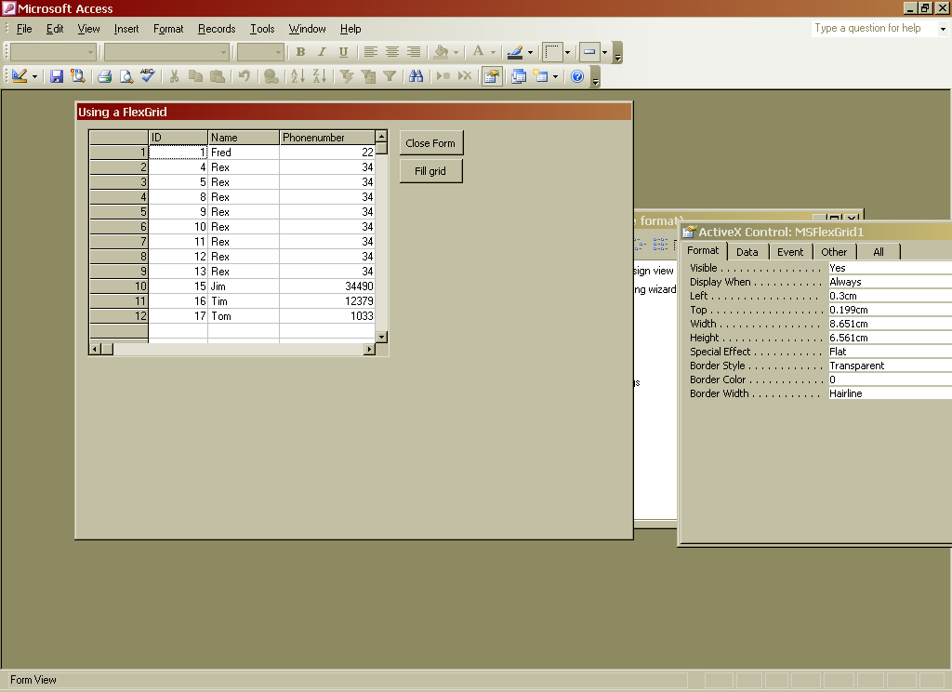
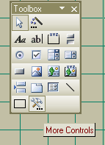
Command, Recordset and FlexGrid
MS FlexGrid not standard control
Get it by 'More controls' on toolbox

Slide 25
FlexGrid 1 – get the data
Dim conn As ADODB.Connection
Set conn = New ADODB.Connection
conn.Provider = "Microsoft.Jet.OLEDB.4.0"
conn.Open "c:/walter/ass21.mdb"
Dim myCommand As ADODB.command
Set myCommand = New ADODB.command
myCommand.ActiveConnection = conn
myCommand.CommandText = "select * from myTable"
Dim rs As ADODB.Recordset
Set rs = myCommand.Execute
command returns a recordset

Slide 26
FlexGrid2 – setting it up
set number of columns – 1 more than field count
Dim fieldCount As Integer
fieldCount = rs.Fields.count
MSFlexGrid1.Cols = fieldCount + 1
MSFlexGrid1.AllowUserResizing = flexResizeColumns
MSFlexGrid1.Rows = 50
For i = 0 To fieldCount - 1
MSFlexGrid1.TextMatrix(0, i + 1) = rs.Fields(i).Name
Next
put fieldnames into top row

Slide 27
FlexGrid 3 – recordset -> grid
rs.MoveFirst
count = 1
Do While Not rs.EOF
MSFlexGrid1.TextMatrix(count, 0) = count
For i = 0 To fieldCount - 1
MSFlexGrid1.TextMatrix(count, i + 1) = rs.Fields(i)
Next
count = count + 1
rs.MoveNext
Loop
rs.Close
for each record..
put record number at left.
for each field in row.
place field value in grid

Slide 28
RecordSet object things - cursor
The cursor is the 'current row'
There are different kinds of cursors with different effects
You select the cursor type before opening the recordset

Slide 29
Cursor types
Static. Is snapshot – changes by other users are invisible. adOpenStatic
ForwardOnly. Like the above but you can only move forward through rows – more efficient. adOpenForwardOnly
Dynamic. Changes by others seen, move anywhere. adOpenDynamic
Keyset. Like dynamic, but can't see rows added by others. adOpenKeyset
(but you don't always get this – it depends on the way the recordset is generated)

Slide 30
Data Locking
Danger – 2 users processing the same data at the same time might over-write each others work
Solution – the first user puts a 'lock' on the data which prevents others using it at the same time

Slide 31
Types of lock
adLockReadOnly - you are only reading records so they are not locked
adLockPessimistic – record locked when you access it, released when finished
adLockOptimistic – record only locked when you update it – might go wrong
adLockBatchOptimistic - only locked when do batch update

